Slide 1
Sun-Shine Farm Inc.
Prepared By
Abu Safayat Arefin
CCSL, J2EE R_37

Slide 2
Software Requirement Specification (SPC)
Requirements:
The application will have following features:
There will be two types of user like admin and customers.
There will be employees like manager, drivers, Guards and farmers.
There will be login for admin and customers.
Customers can register through email.
Admin can see, add & edit every crops, employees etc.
Customers can only see tables like crop list, equipment list etc.
Customers can edit their profile from user-list.
Customers can add their images.

Slide 3
Software Requirement Specification (SPC) Continue……
Manager is responsible for keeping record of expenses and sales of the farm.
Manager is responsible for salary expense, utility expense, rent expense and executive is responsible miscellaneous expenses.
Driver is responsible for car-fuel expense and taking crops from farm to Super-Market with manager.
Executive is responsible for selling crops to Super-Market.
Manager is responsible for purchasing equipment.
Farmers are responsible for purchasing insecticides and pesticides.
Farmers are responsible for growing crops.
Customers purchase crops from Super-Market.
Customers can also purchase crops from farm.

Slide 4
Software Requirement Specification (SPC) Continue……
Analysis & Design:
Brainstorming Diagram
Use Case Diagram
Class Diagram

Slide 5
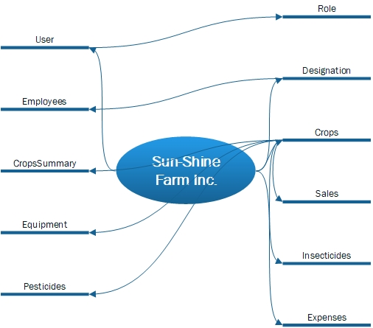
Brainstorming Diagram

Slide 6
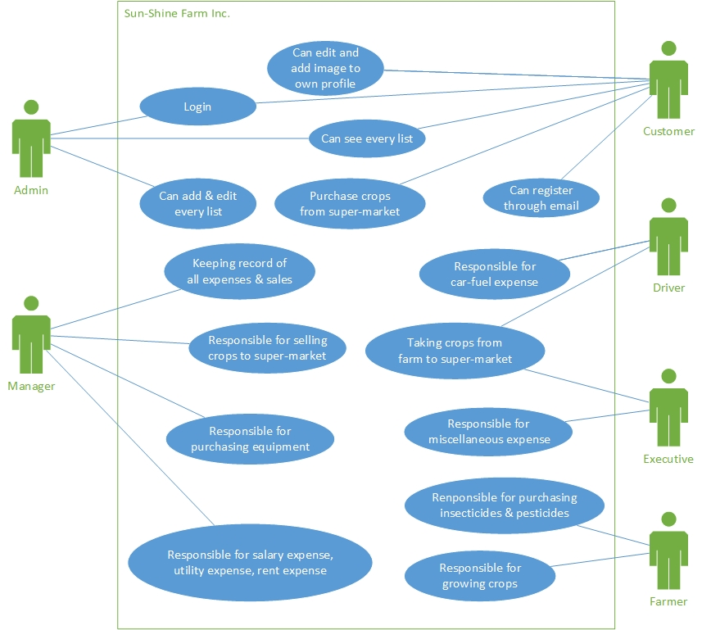
Use Case Diagram

Slide 7
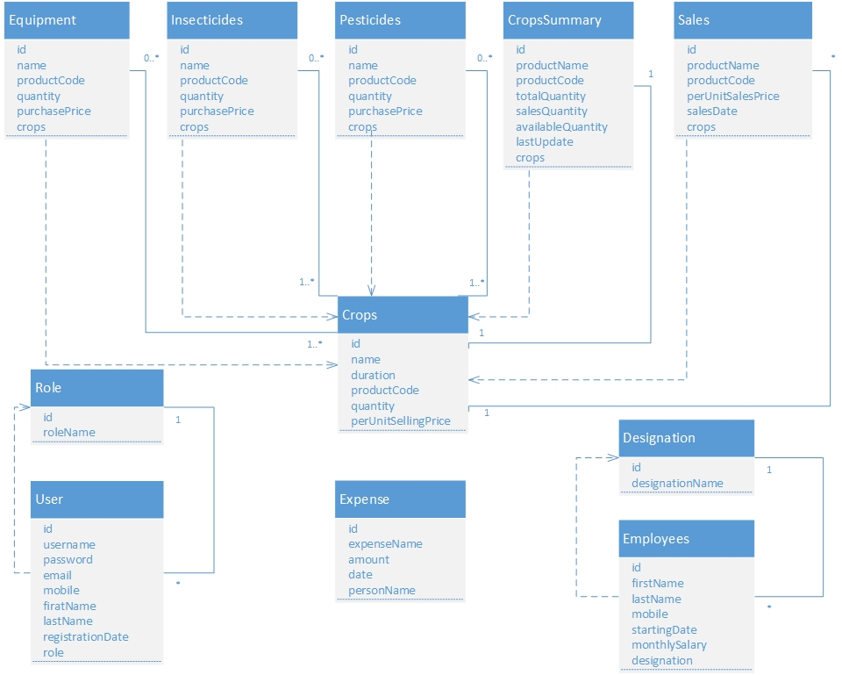
Class Diagram

Slide 8
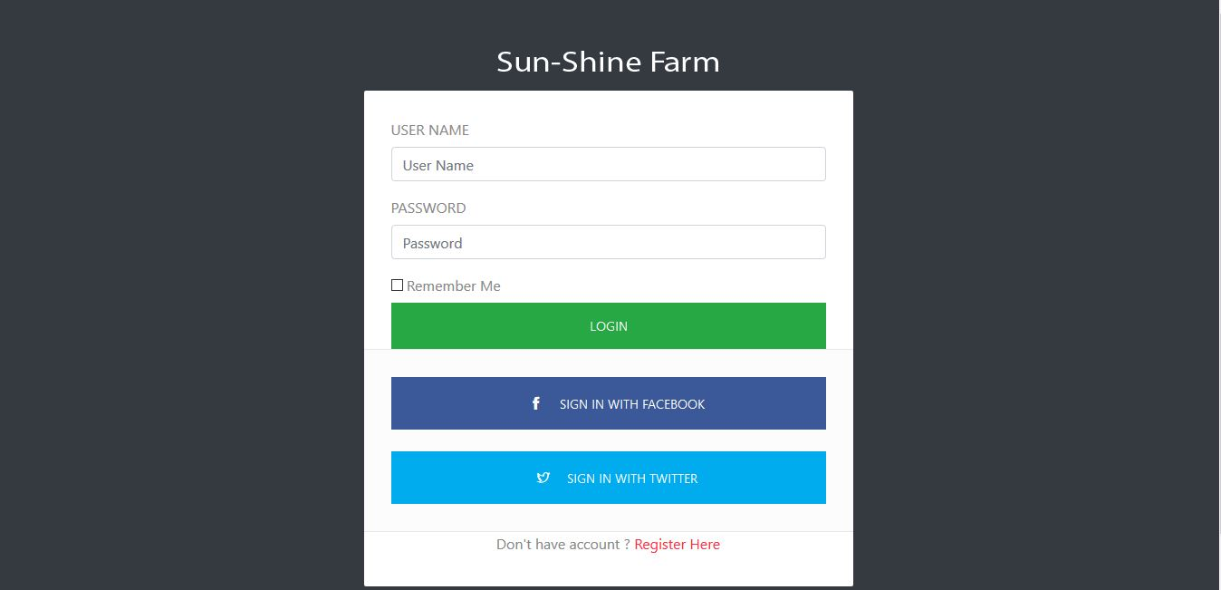

Slide 9
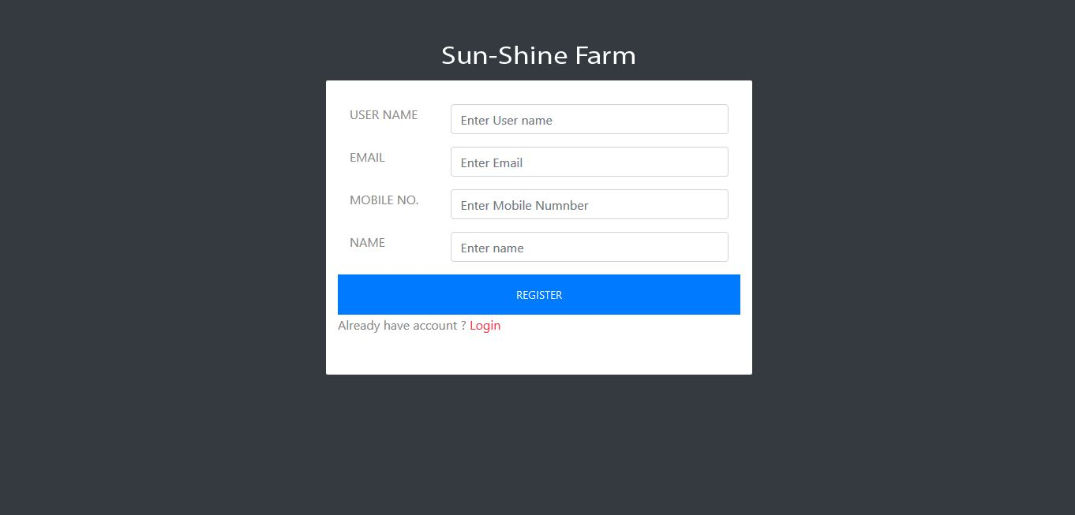

Slide 10
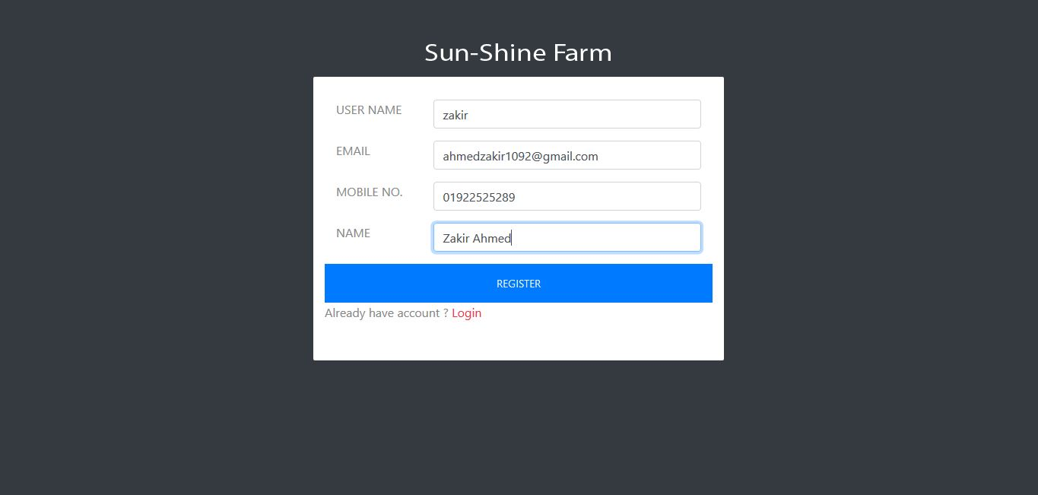

Slide 11
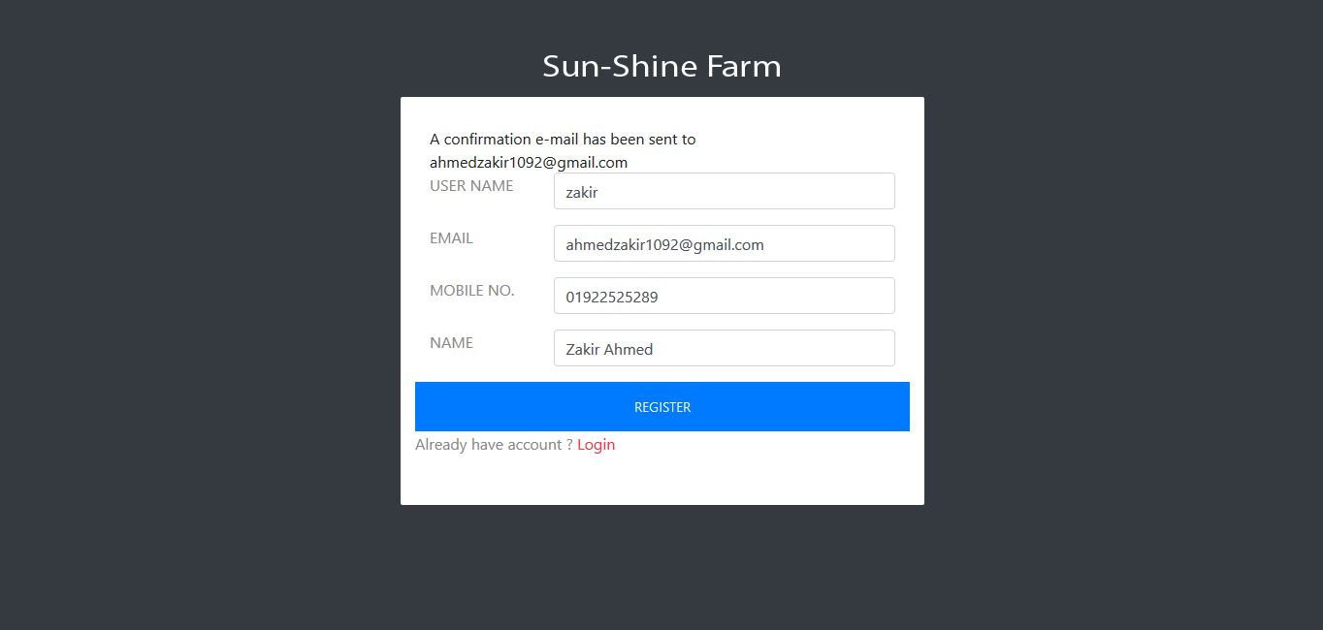

Slide 12
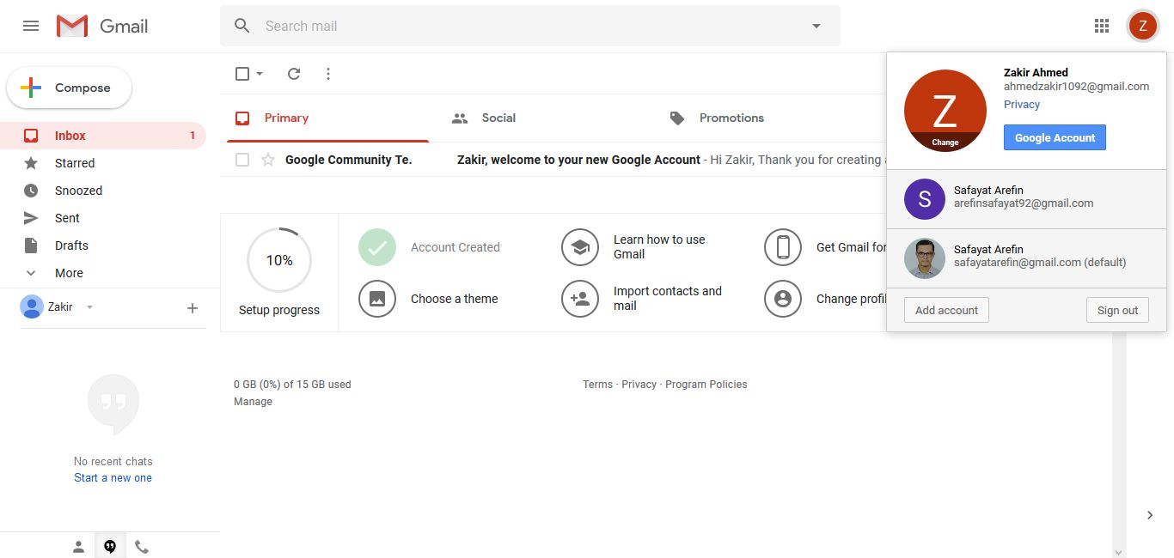

Slide 13
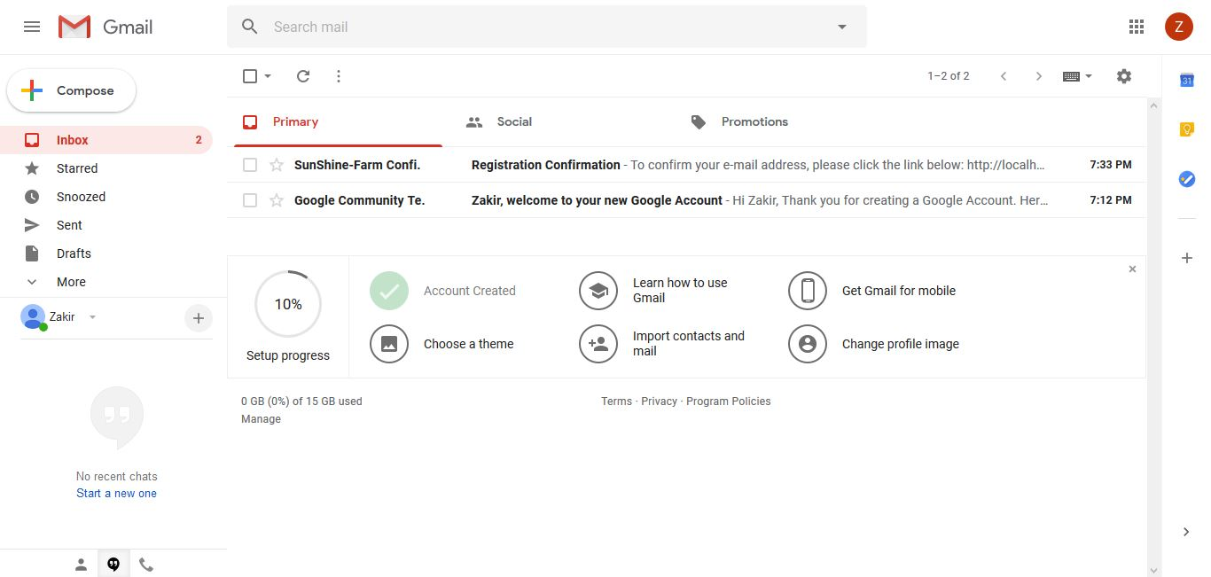

Slide 14
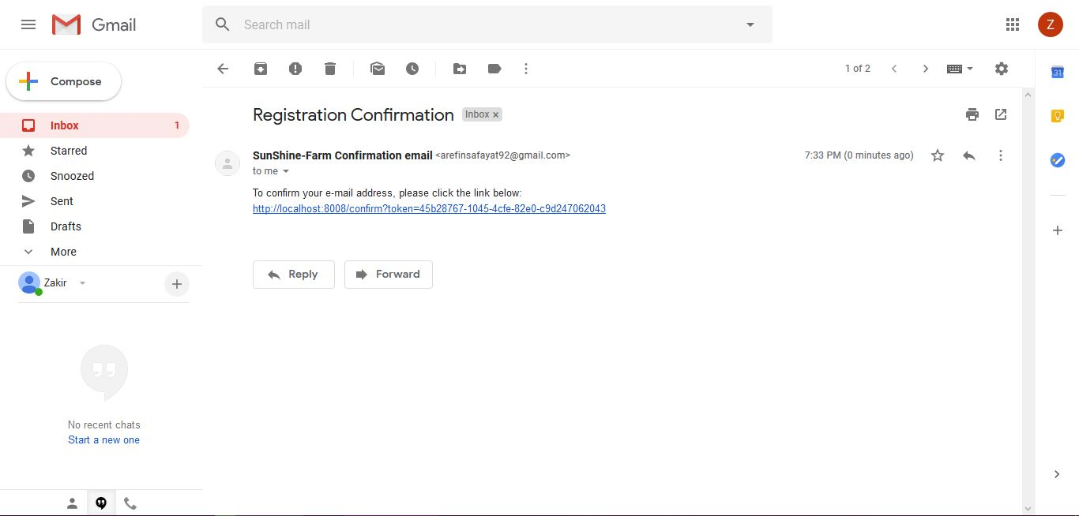

Slide 15
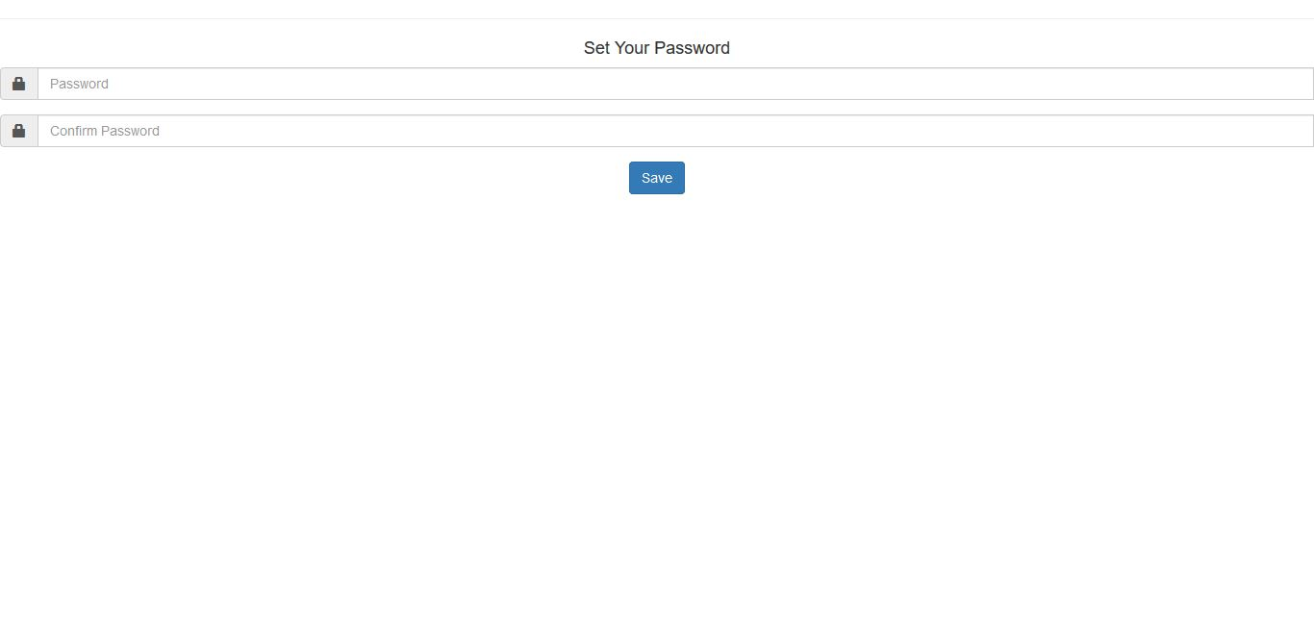

Slide 16
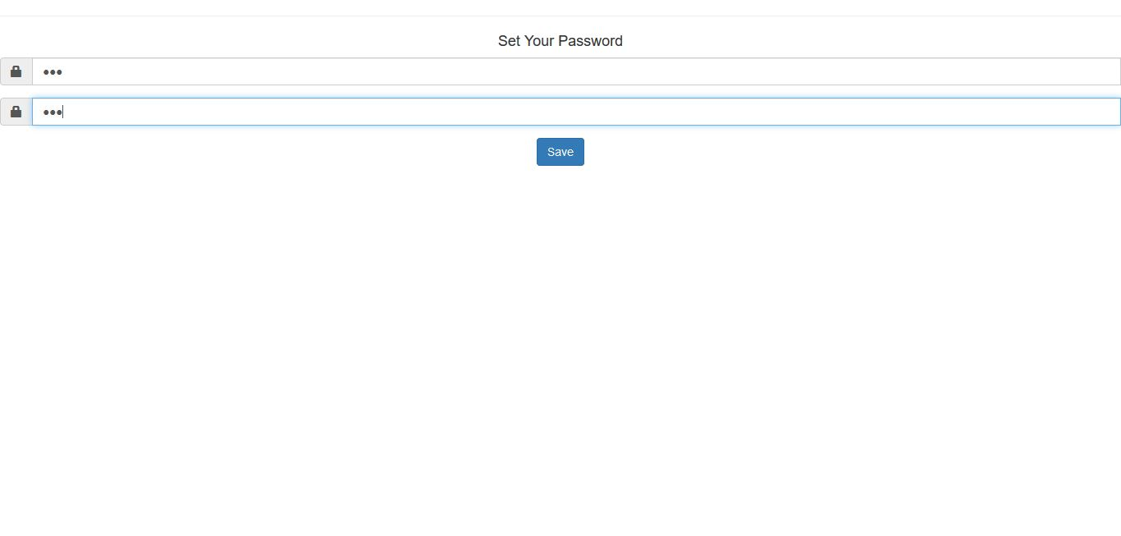

Slide 17
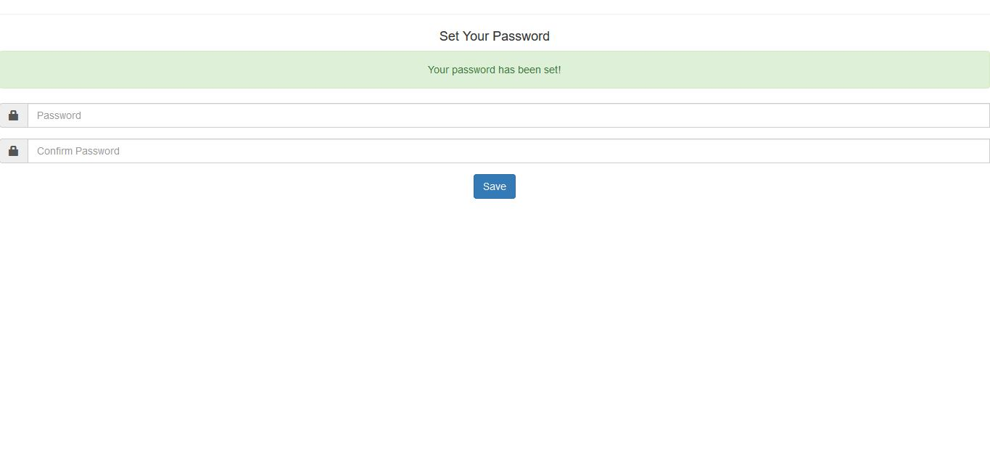

Slide 18
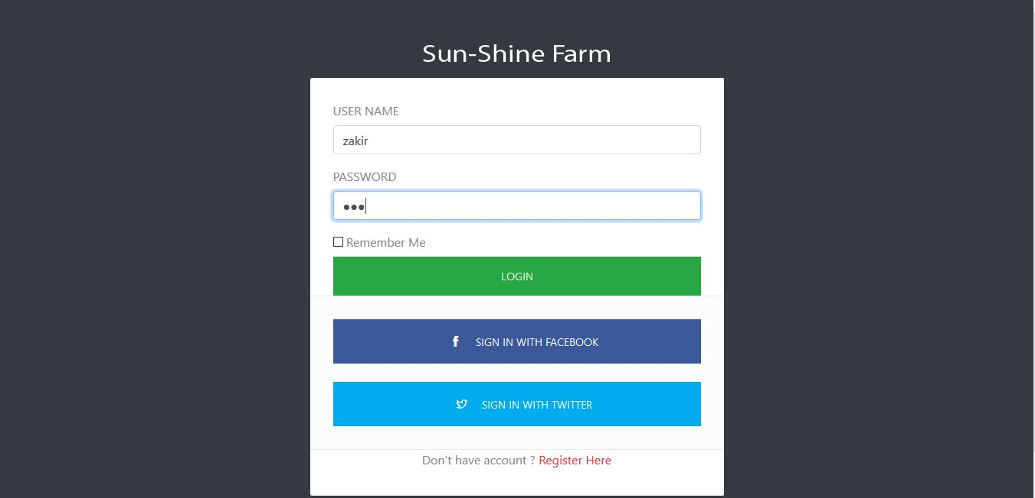

Slide 19
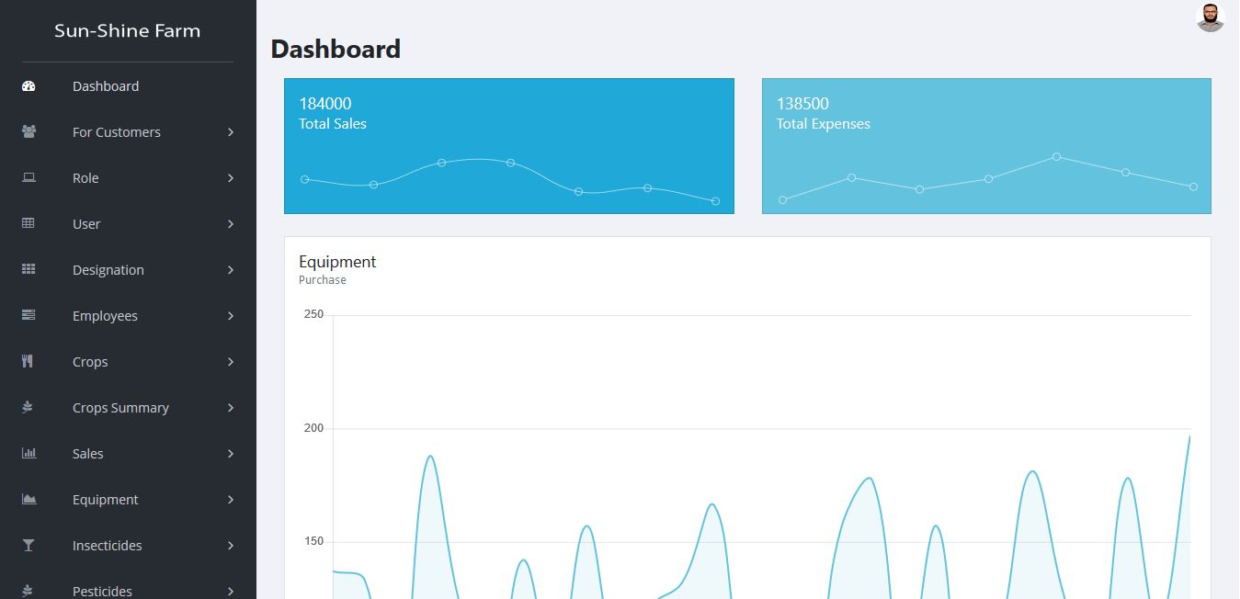

Slide 20
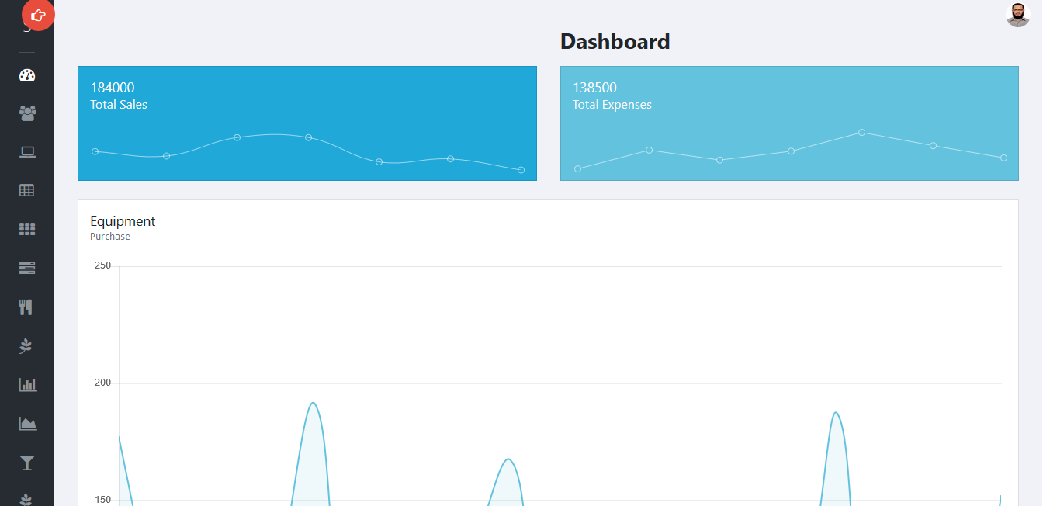

Slide 21
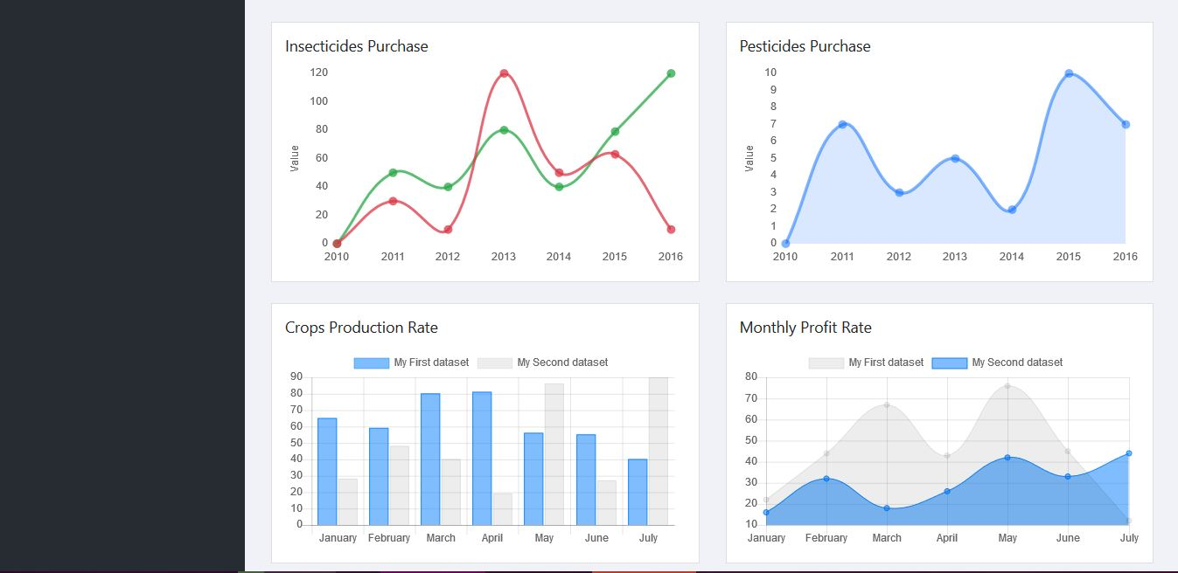

Slide 22
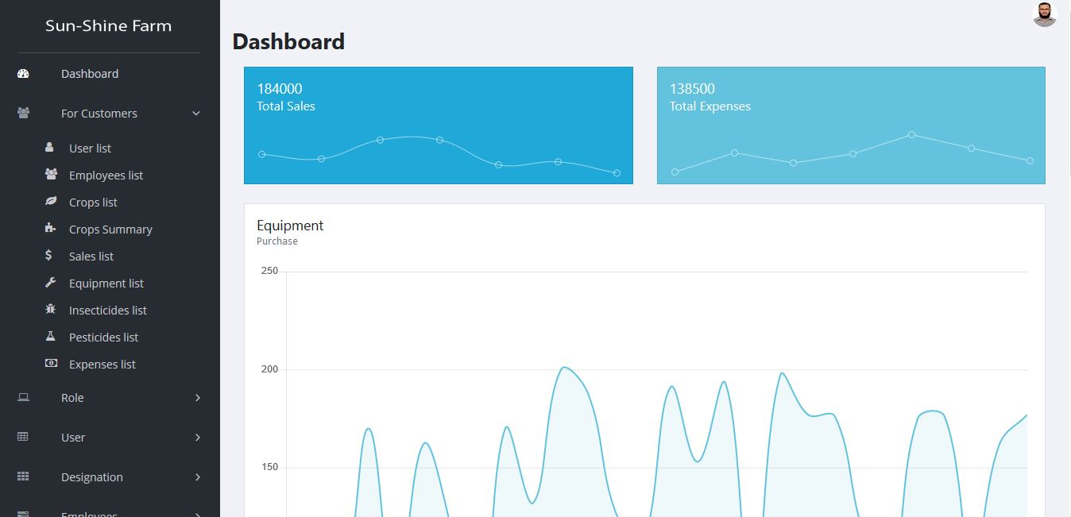

Slide 23


Slide 25
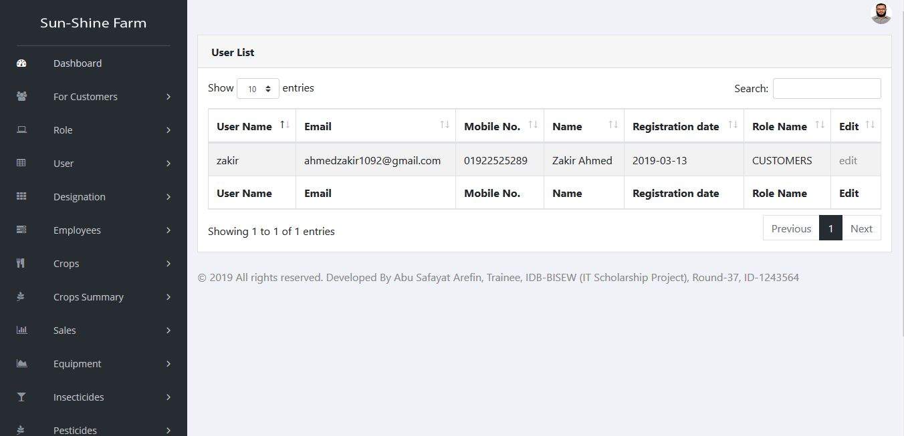

Slide 26
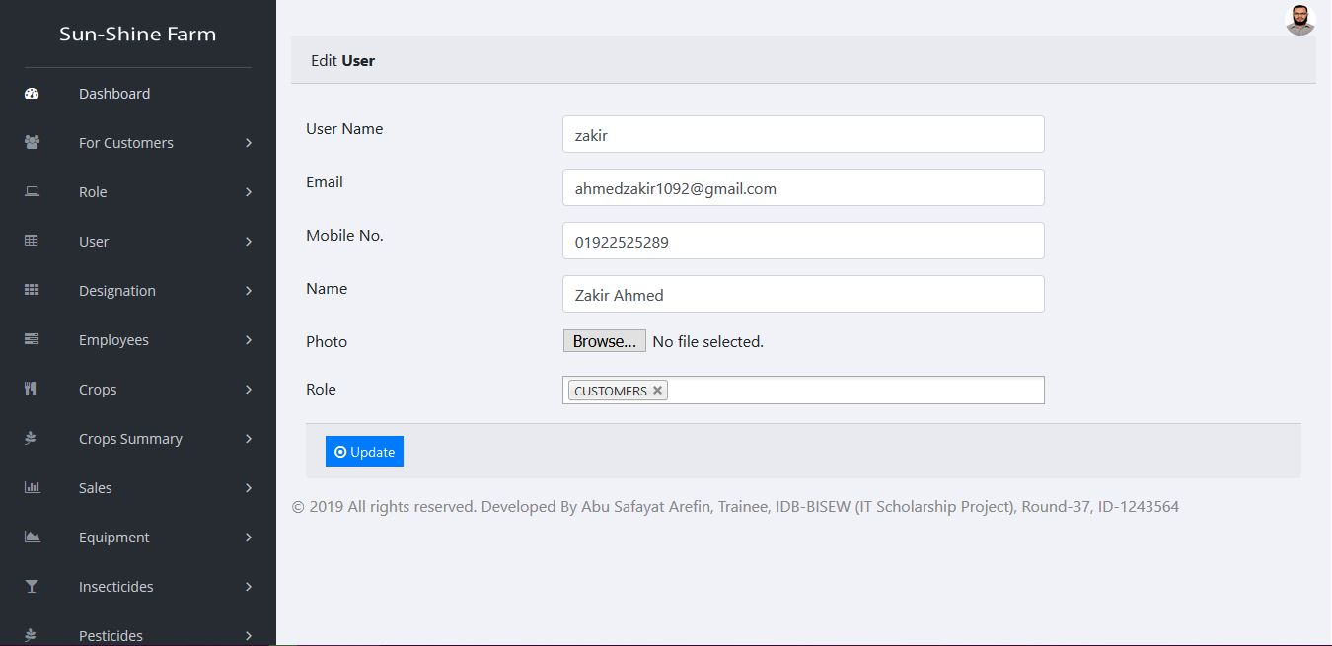

Slide 27
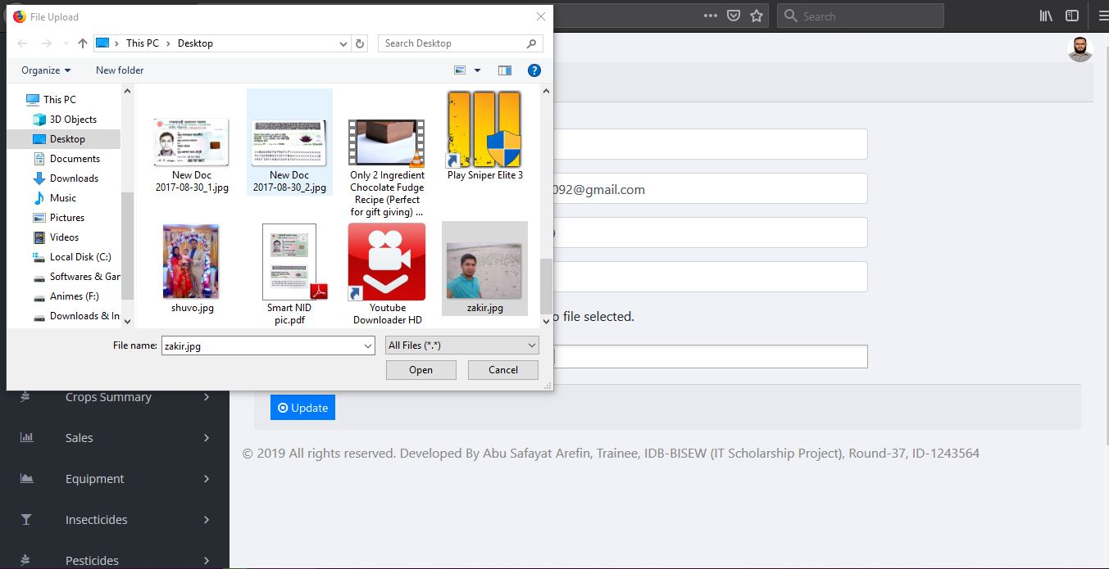

Slide 28
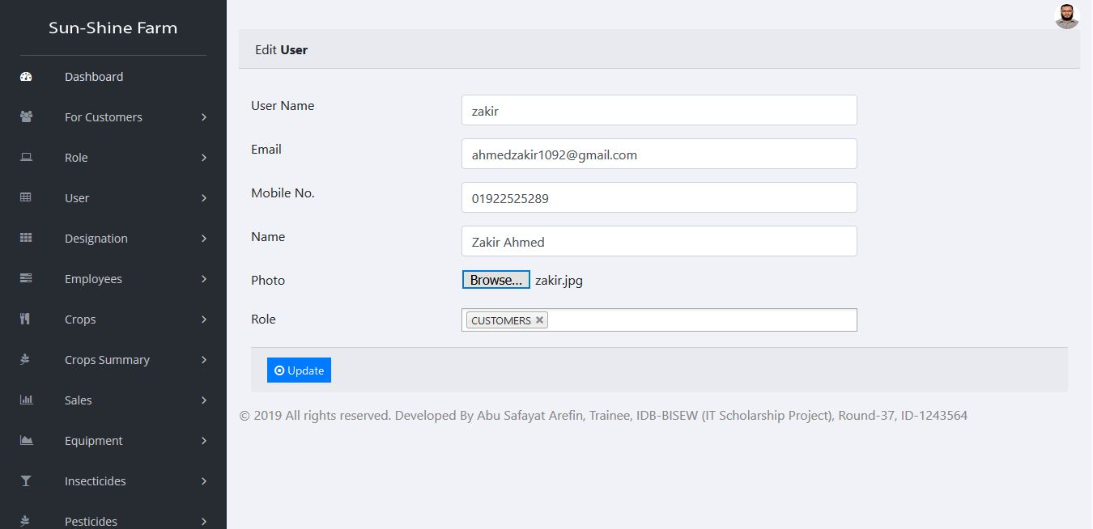

Slide 29
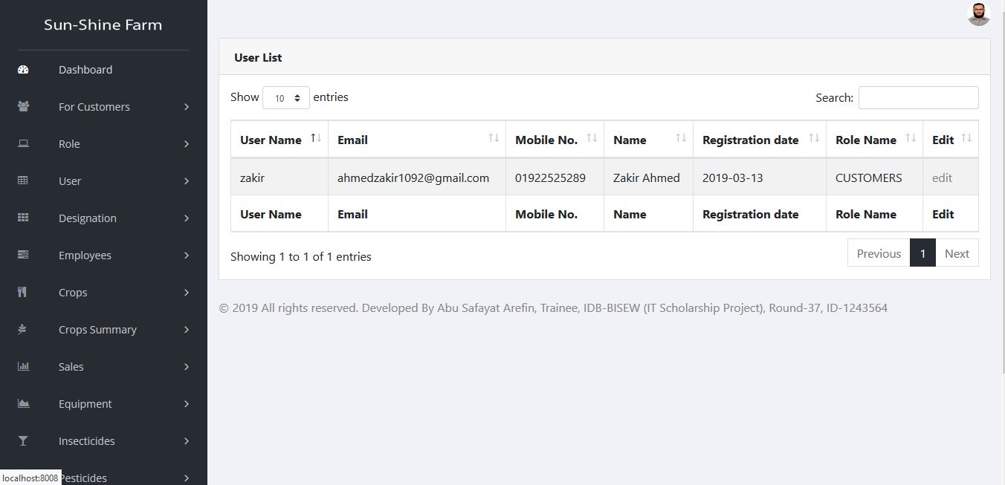

Slide 30
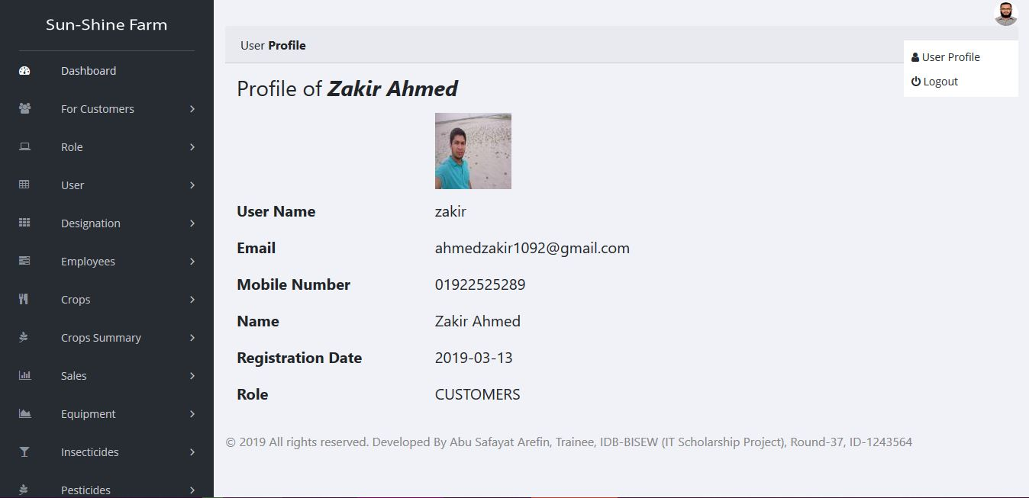

Slide 31
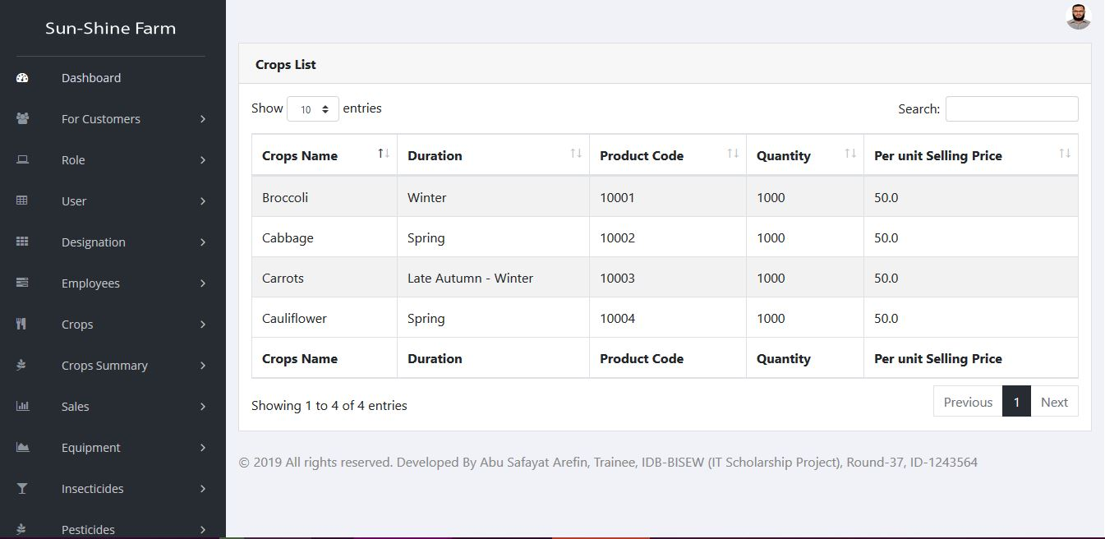

Slide 32
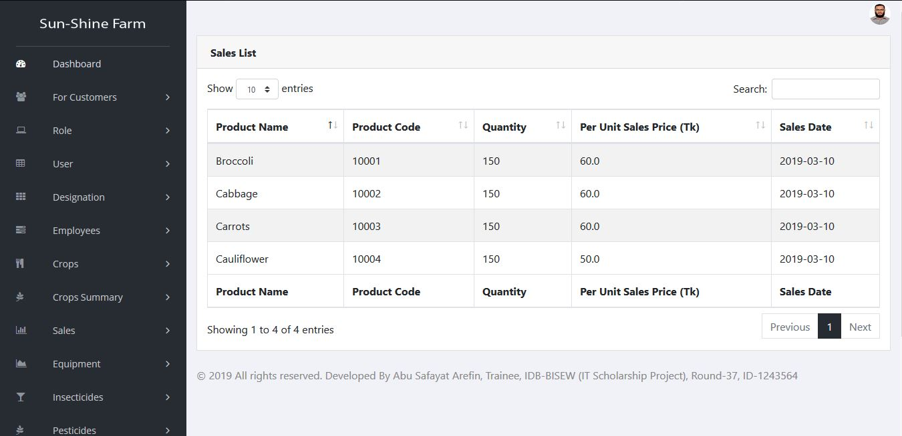

Slide 33
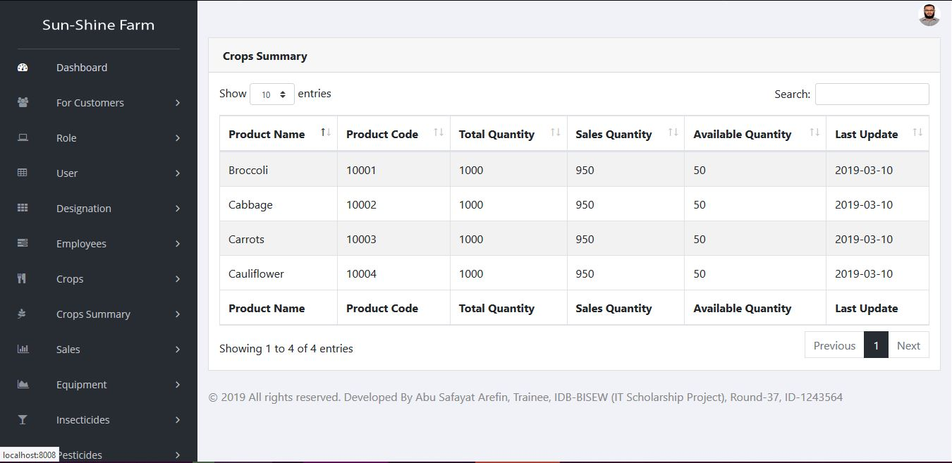

Slide 34
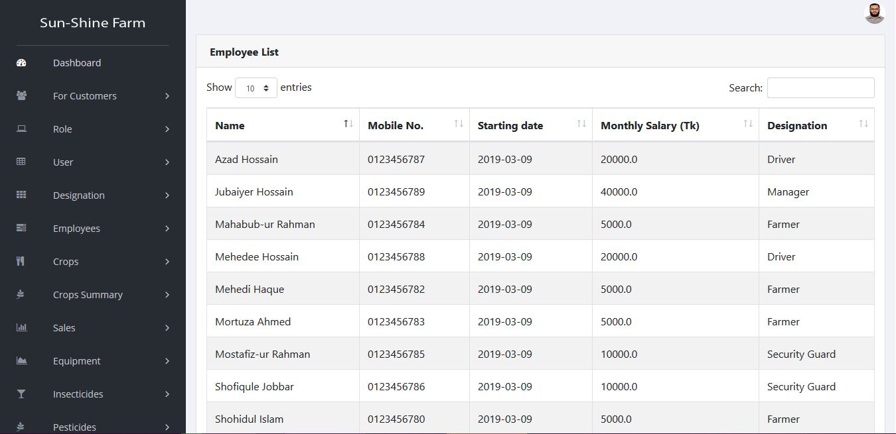

Slide 35
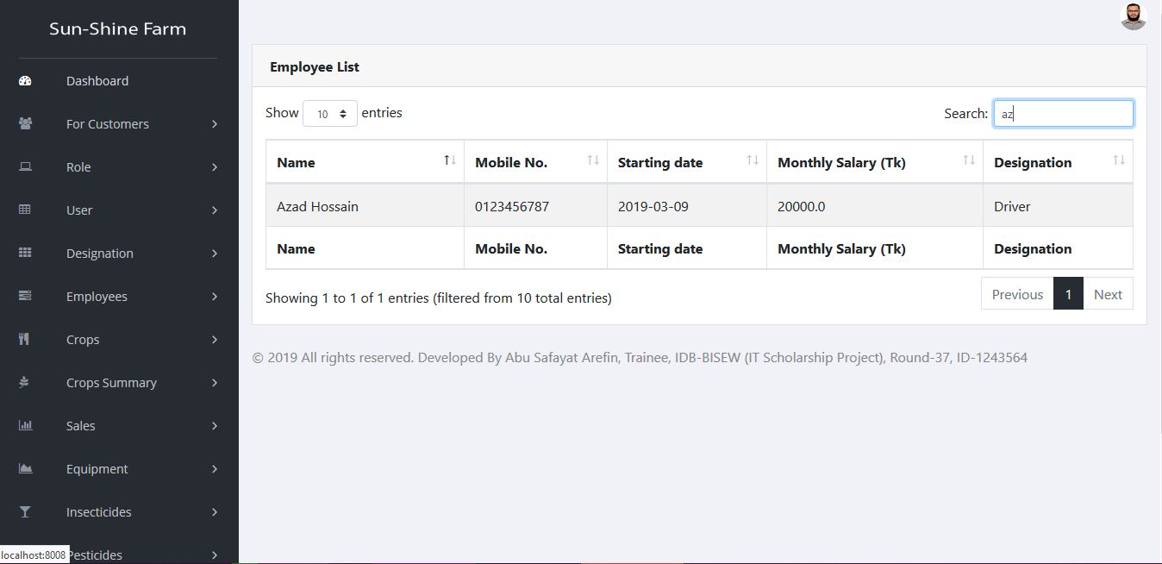

Slide 36
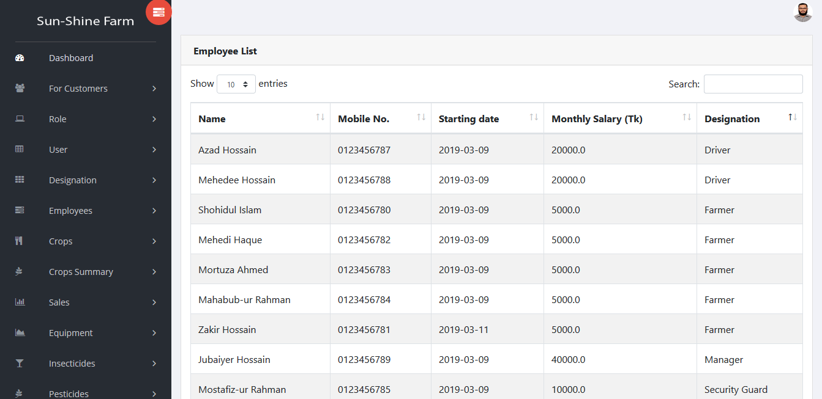

Slide 37
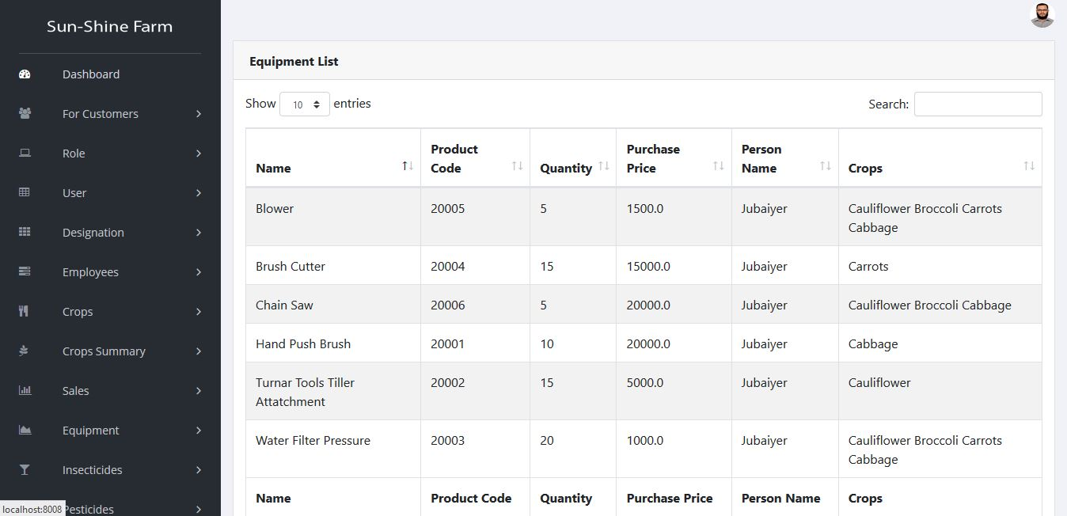

Slide 38
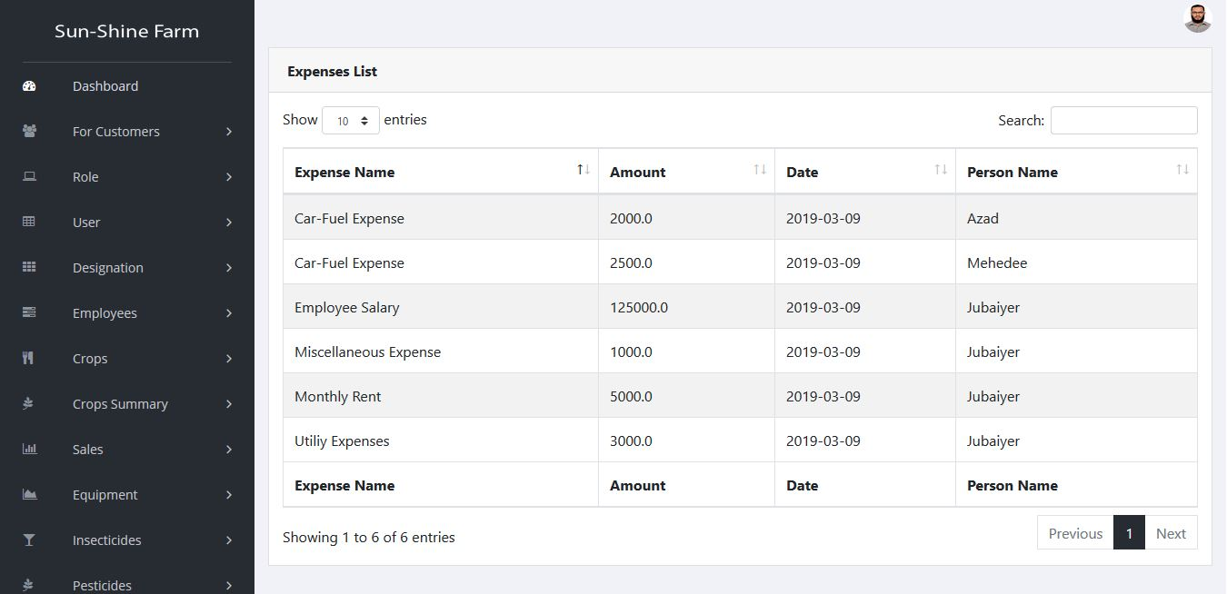

Slide 39
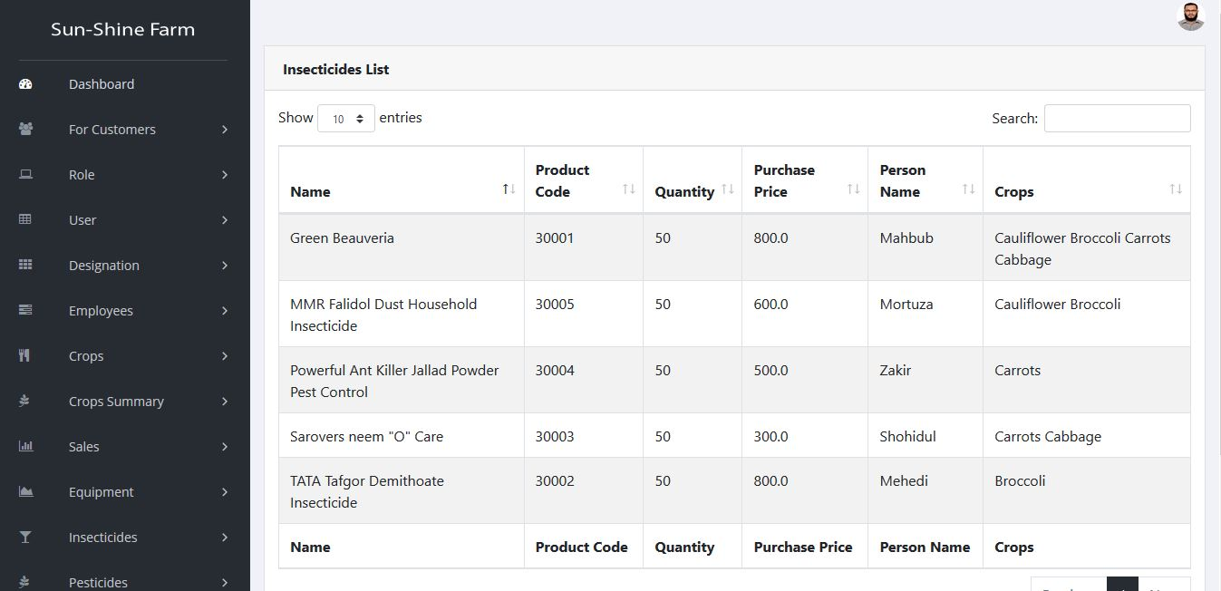

Slide 40
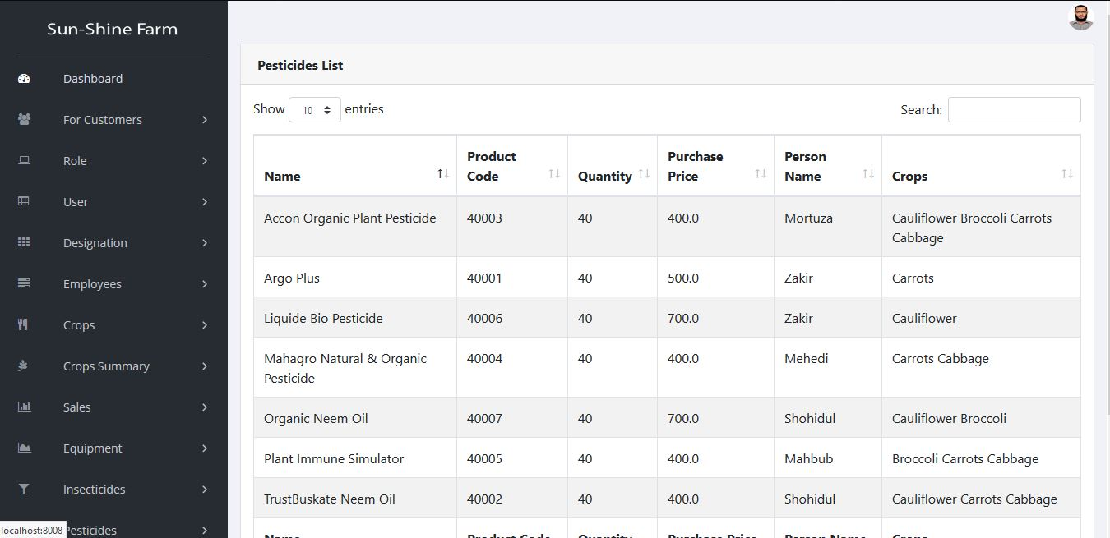

Slide 41
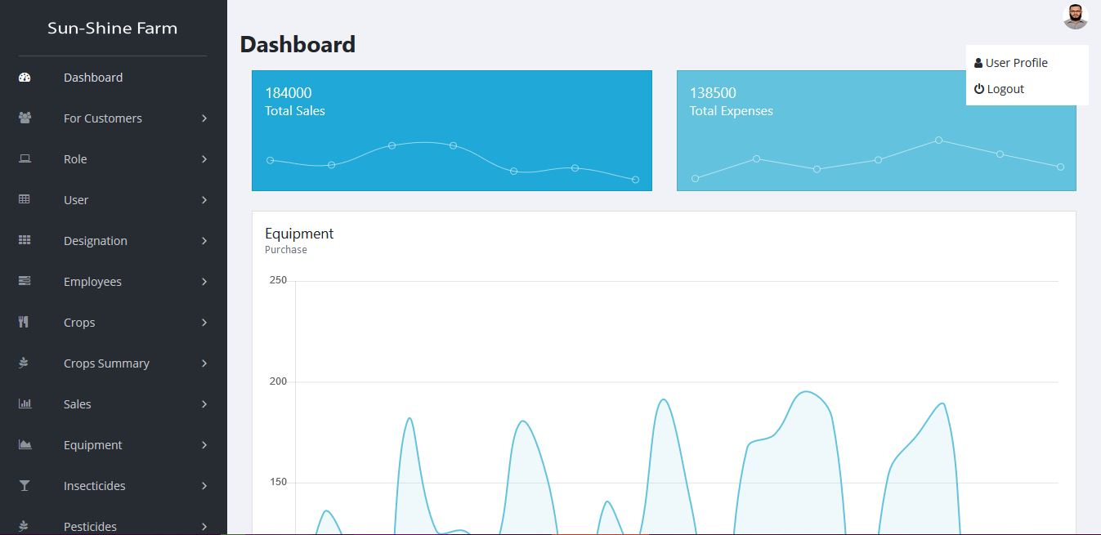

Slide 42
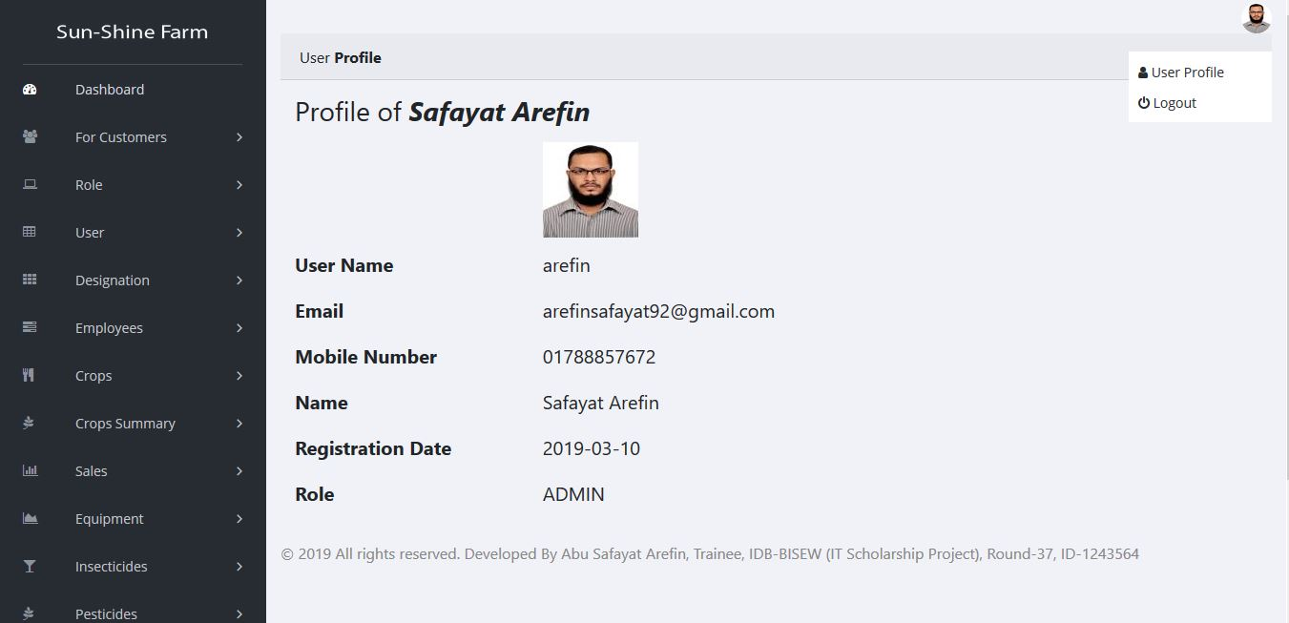

Slide 43
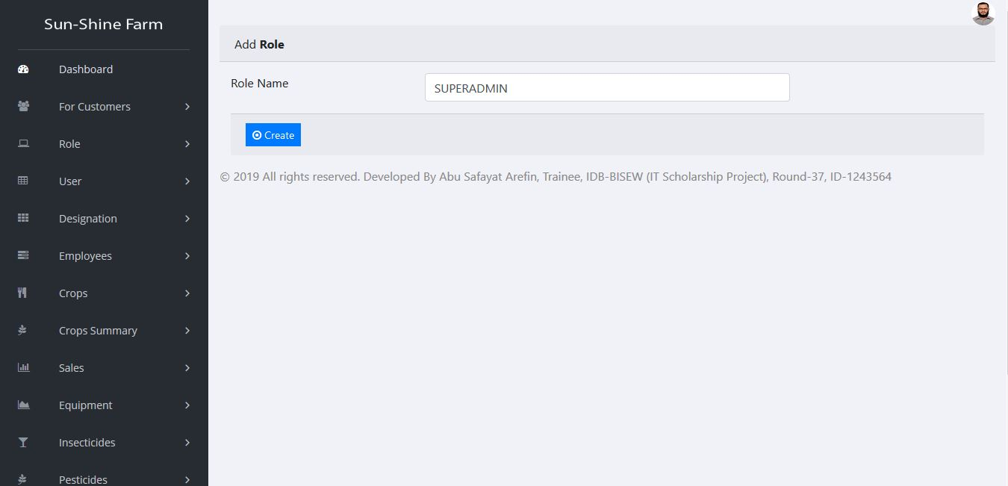

Slide 44
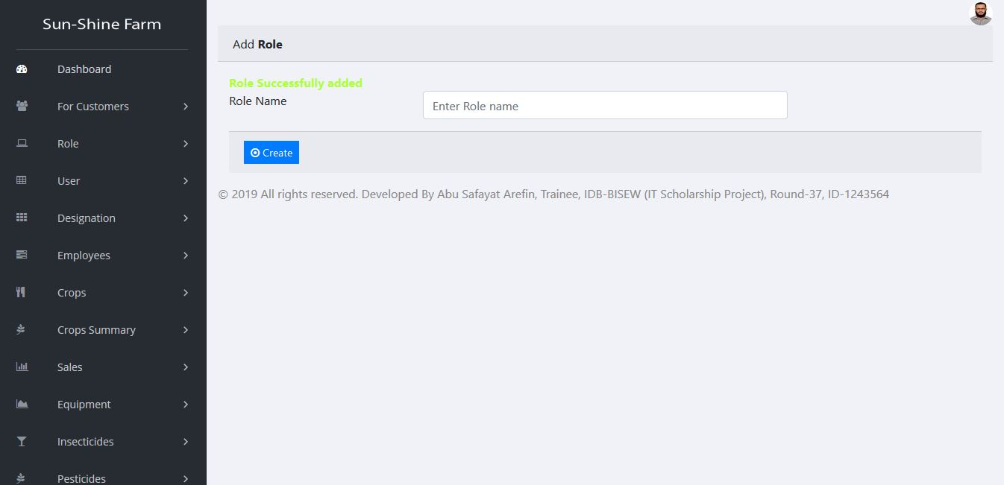

Slide 45
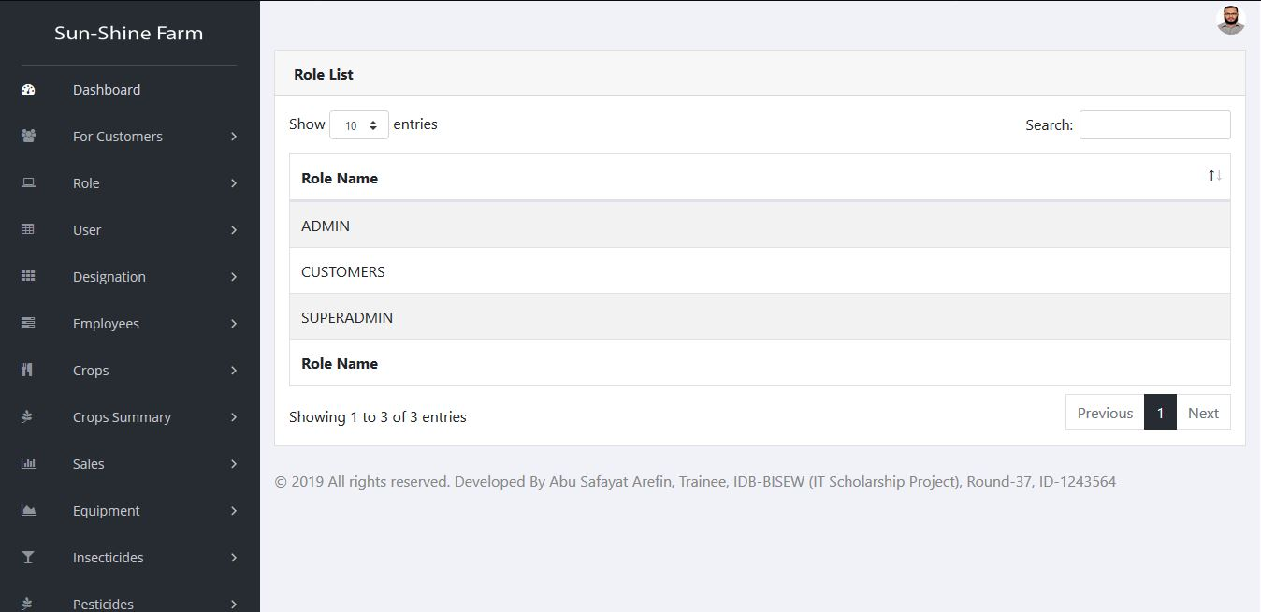

Slide 46
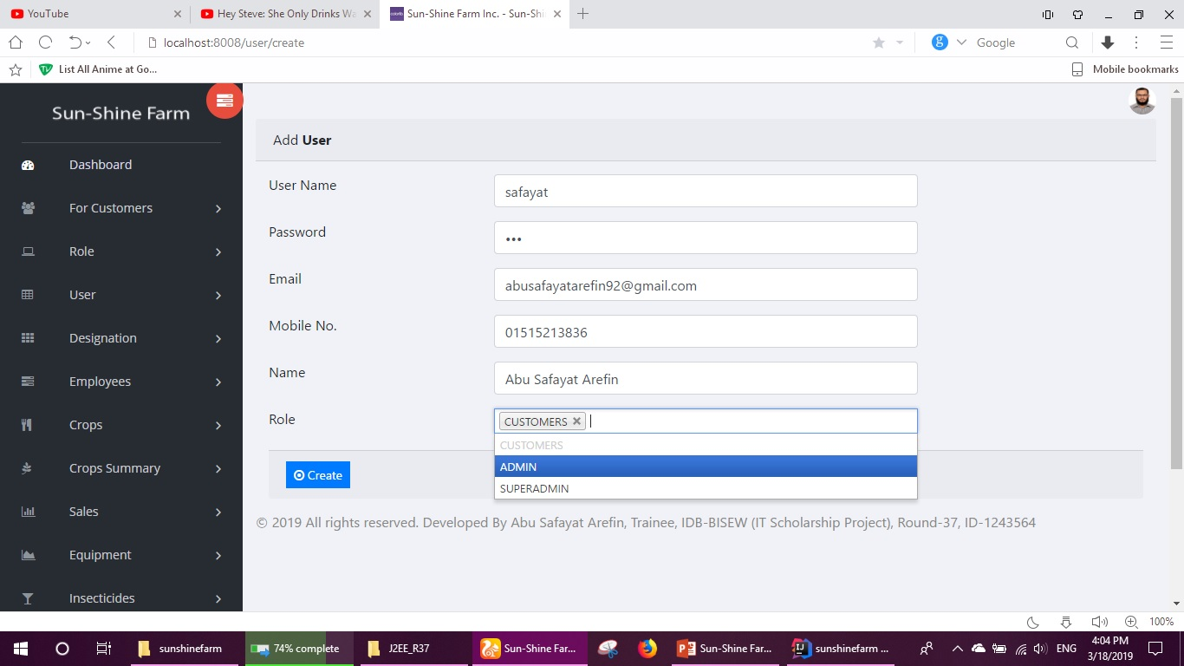

Slide 47
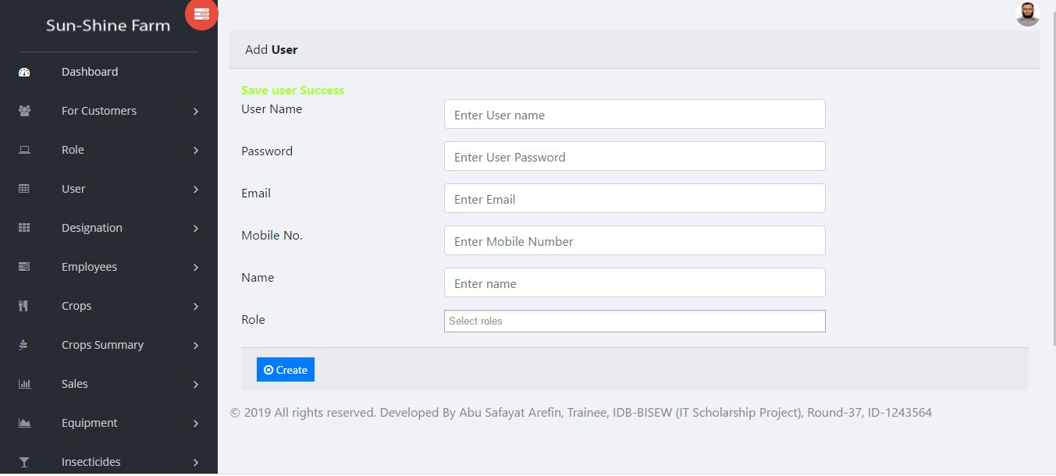

Slide 48
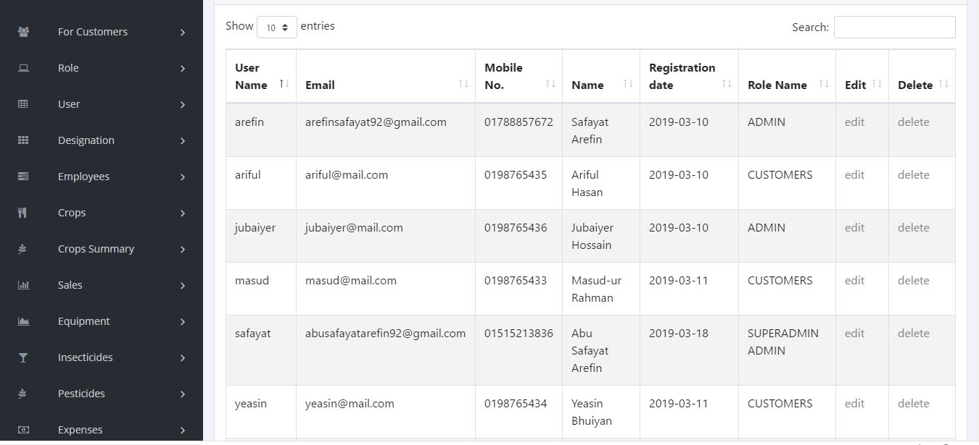

Slide 49
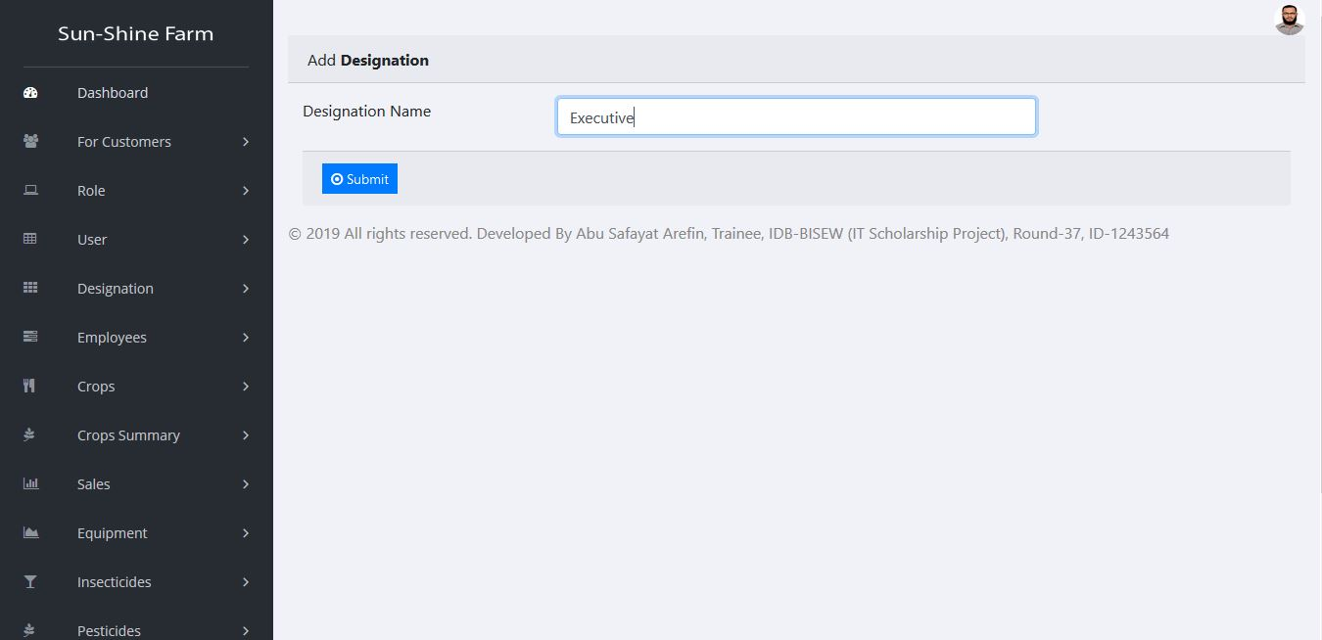

Slide 50
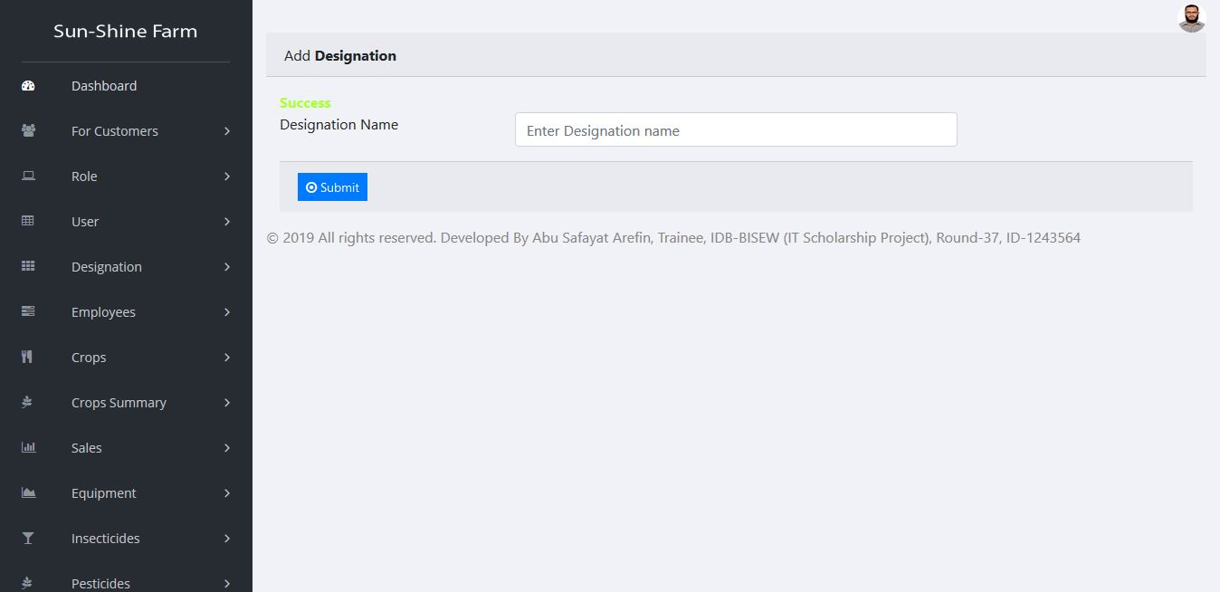

Slide 51
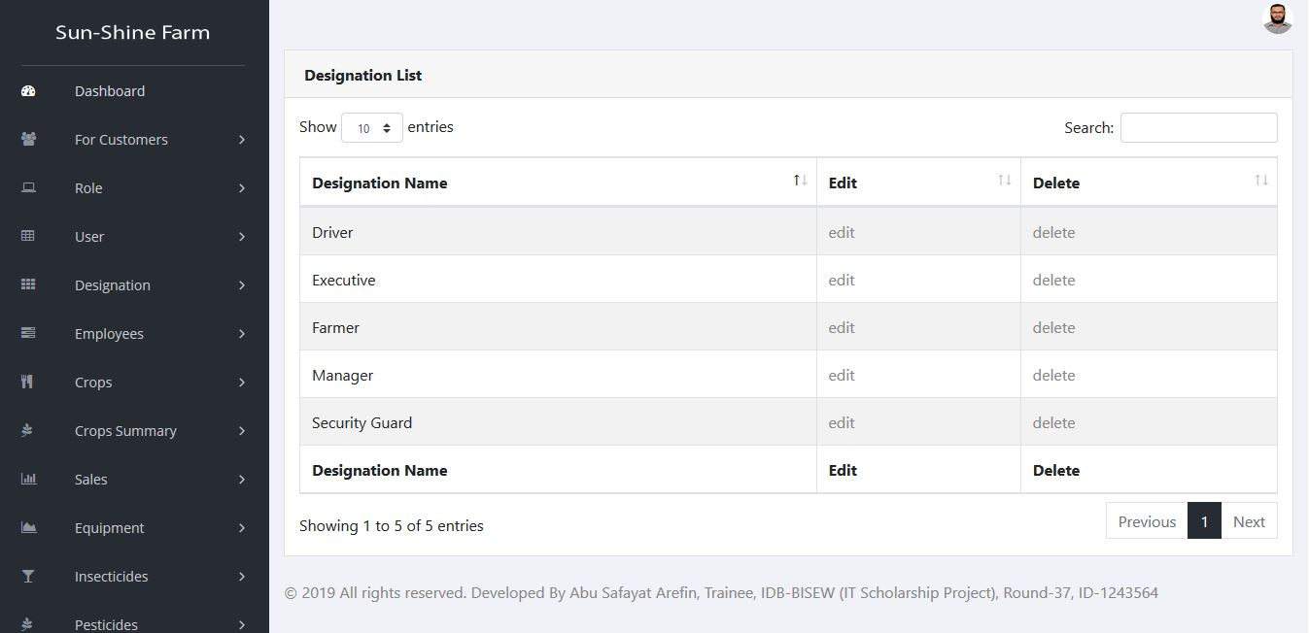

Slide 52
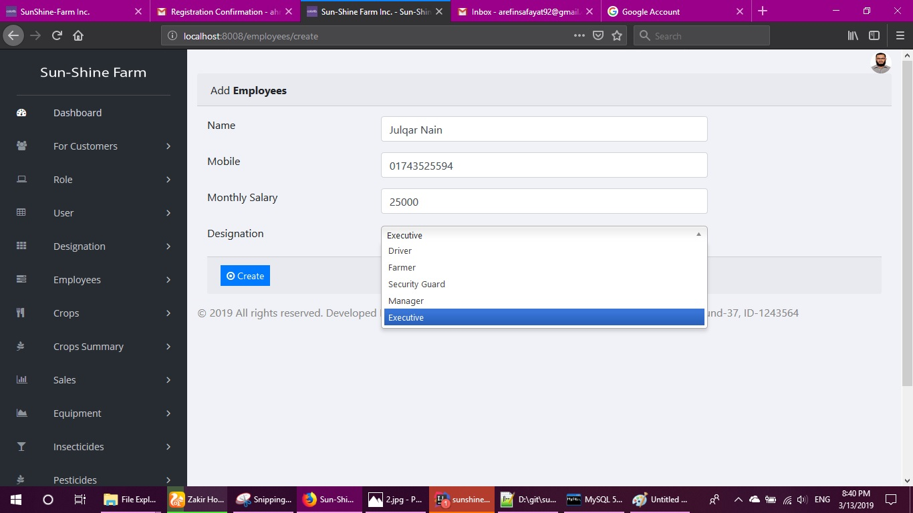

Slide 53
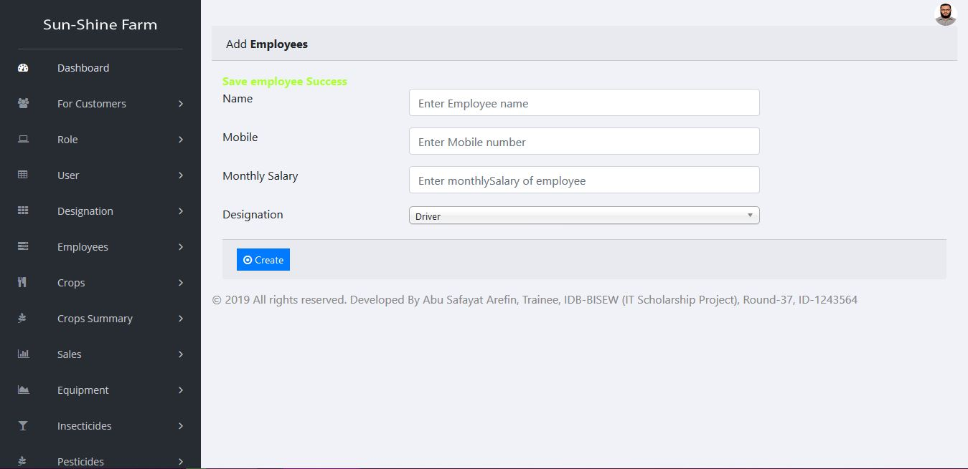

Slide 54
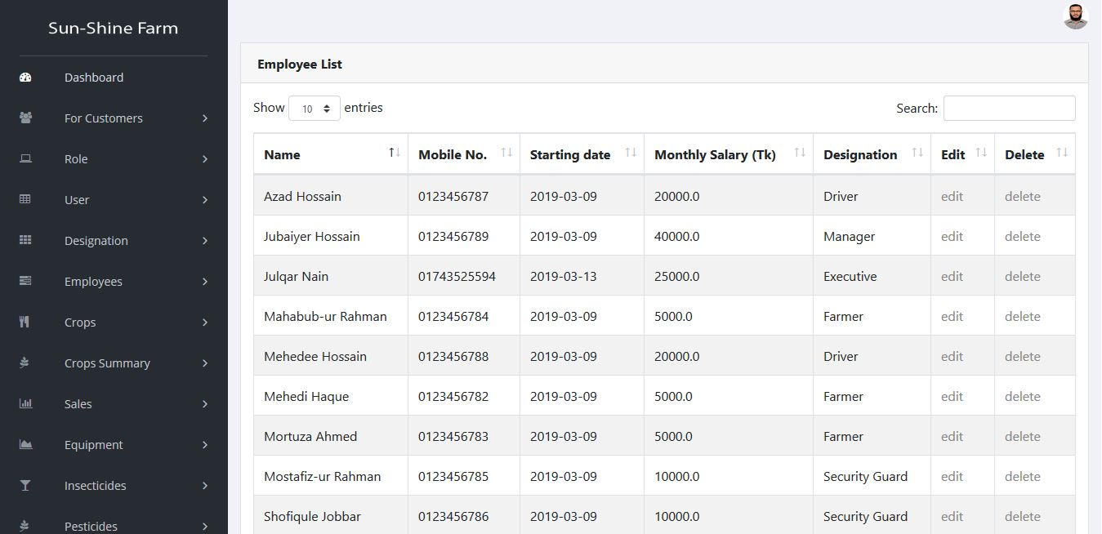

Slide 55
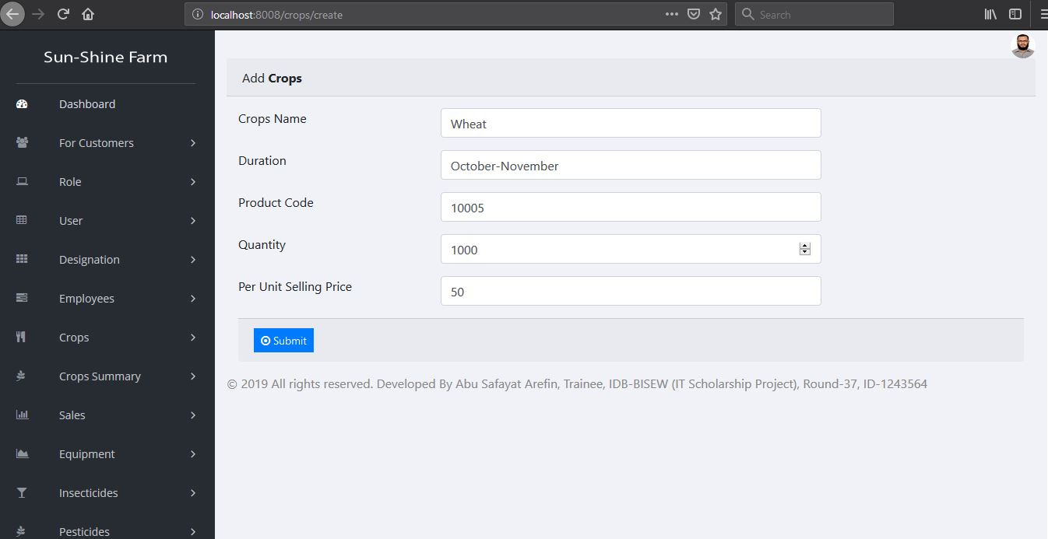

Slide 56
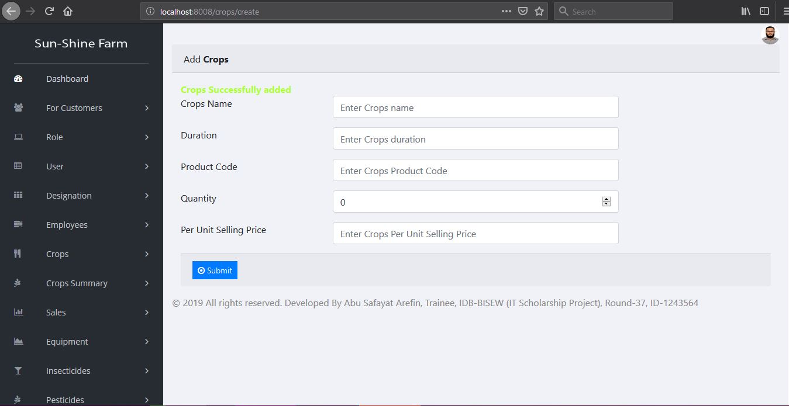

Slide 57


Slide 58


Slide 59


Slide 60


Slide 61


Slide 62


Slide 63


Slide 64


Slide 65


Slide 66


Slide 67


Slide 68


Slide 71
Thank You !

